Slide 1
Comparing Apples, Oranges and Grapes?

Slide 2
How do you compare apples, oranges and grapes?
6 Apples
$6.00
1.2 kg
5 oranges
$5.50
1.0 kg
A bunch of grapes
$8.00
1.5 kg

Slide 3
Based on quantity
6 Apples
$6.00
1.2 kg
5 oranges
$5.50
1.0 kg
A bunch of grapes
$8.00
1.5 kg
Cost of 1 apple
Cost of 1 orange
Cost of 1 grape
$1.00/apple
$1.10/orange

Slide 4
Based on weight
6 Apples
$6.00
1.2 kg
5 oranges
$5.50
1.0 kg
A bunch of grapes
$8.00
1.5 kg
Cost of 1 kg of apples
Cost of 1 kg of oranges
Cost of 1 kg of grapes
$5.00/kg of apple
$5.50/kg of orange
$5.33/kg of grapes

Slide 5
Methods of comparison
Method | Apples | Oranges | Grapes
Based on quantity | $1.00/apple | $1.10/orange | N/A
Based on weight | $5.00/kg | $5.50/kg | $5.33/kg
Discuss the following:
What other methods can you used to compare apples, oranges and grapes?
Will the other methods give you the same answers?
If you consider buying something else like orange juices or apple juices, what are the unit measurement you can use to compare the prices?
Can you think of any other examples?

Slide 6














How about buying different size of similar goods?

Slide 7
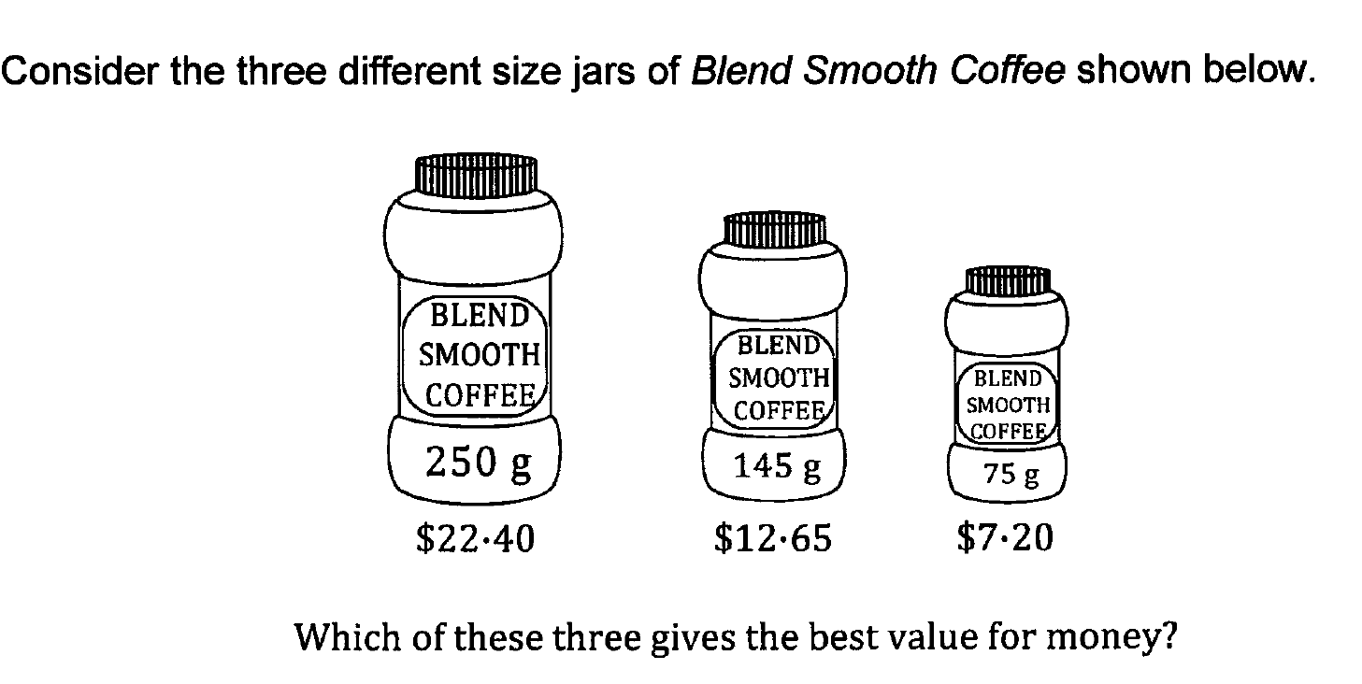


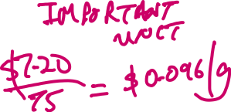









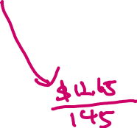








Slide 8
Sources of photographs/pictures
Slide 1
http://www.livestrong.com/article/419969-what-are-the-benefits-of-apples-oranges-grapes/
http://www.clipartpanda.com/clipart_images/frequently-asked-questions-6246245
http://www.clipartpanda.com/clipart_images/question-mark-clipart-6246545
Slides 2, 3 & 4
http://www.cngfloristsundries.co.uk/artificial-fruit/6-artificial-decorative-apples-red-yellow-3066.html
http://vohnsvittles.com/2014/03/page/8
https://en.wikipedia.org/wiki/Grape

